Slide 1


TRANSPORT LAYER SECURITY (TLS).
Subject : Cyber Security and Data Protection
Presented by : Jenil Arvindbhai Paladiya
Matriculation Number : 4243558

Slide 2
INDEX
01
Overview of TLS and its Main Components
02
How TLS Works (Handshake Process)
03
Main Services Where TLS is Applied
04
Crypto Algorithms Used in TLS and Their Selection
05
Benefits of TLS
06
Limits of TLS
07
Real-World Examples and Case Study
08
Conslusion

Slide 3
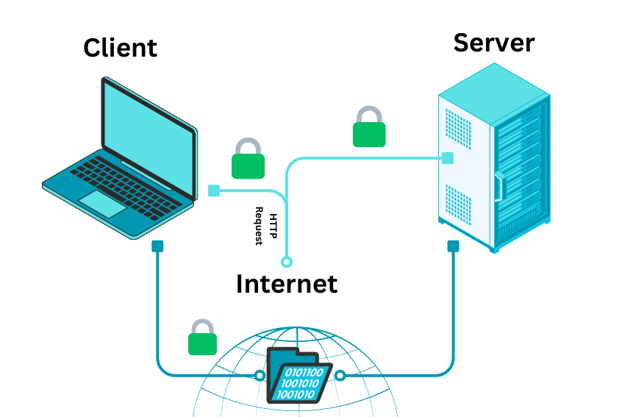
OVERVIEW OF TLS AND ITS MAIN COMPONENTS
Definition: TLS (Transport Layer Security) is a cryptographic protocol that ensures secure communication over the internet by encrypting data between devices.
Encryption
Function: Encrypts the data, ensuring that no one can read it during transmission.
Authentication
Function: Verifies the identity of the communicating parties, ensuring the right server is being communicated with.
Data Integrity
Function: Ensures that data is not tampered with during transmission, maintaining its authenticity.
Session Keys
Function: Uses temporary, symmetric keys for faster encryption during a session.

Slide 4
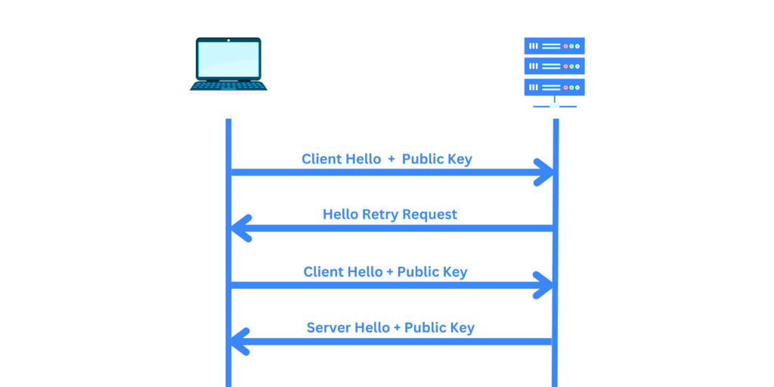
HOW TLS WORKS (HANDSHAKE PROCESS)
Step 1: Client Hello
The client initiates the handshake by sending supported TLS versions, cipher suites, and other relevant parameters to the server.
Step 2: Server Hello
The server responds with its chosen configuration and sends a digital certificate to authenticate its identity.
Client
Server
Step 3: Certificate Verification
The client checks the server's certificate to verify its authenticity, ensuring it's signed by a trusted Certificate Authority (CA).
Step 4: Key Exchange
Both the client and server exchange keys (using asymmetric encryption) to securely generate a session key for further communication.
Step 5: Secure Communication
Encrypted data transfer begins using the session key for encryption and decryption, ensuring confidentiality and integrity of data.

Slide 5





MAIN SERVICES WHERE TLS IS APPLIED
Service Type | Example | Icon/Image
Web Browsing | HTTPS secure websites
Email Services | IMAP, SMTP encryption
Online Payments | E-commerce payment gateways
VPN Connections | Secure tunneling for remote workers
VoIP Services | Encrypted voice communication

Slide 6




CRYPTO ALGORITHMS USED IN TLS AND THEIR SELECTION
Algorithm Type | Example | Purpose | Icon/Image
Key Exchange | ECDHE | Secure key generation
Encryption Algorithm | AES-128, AES-256 | Encrypting
Hashing Algorithm | SHA-256 | Ensures data integrity
Digital Signature | RSA, ECDSA | Certificate validation

Slide 7

BENEFITS OF TLS
TLS offers a wide range of security benefits that ensure the confidentiality, integrity, and trustworthiness of online communications.
Data Security (Encrypts sensitive information)
User Trust (Secure websites display a padlock icon)
Defense Against Attacks (Prevents man-in-the-middle (MITM) attacks)
Authentication (Verifies server identity)

Slide 8
LIMITS OF TLS
While TLS provides robust security, there are certain limitations and challenges that can impact its effectiveness.
Certificate Management (Expired or mismanaged certificates disrupt security)
Performance Overhead (Slight delay due to encryption processes)
Limited Protection Scope (website stores passwords without encryption)
Configuration Issues (Poor server setup can weaken security)

Slide 9

REAL-WORLD EXAMPLES AND CASE STUDY
Case Study (2014 – Google’s Priority on HTTPS):
E-commerce (🛒):
E-commerce websites use TLS to protect customer transactions. TLS ensures that sensitive information such as credit card details and shipping addresses are encrypted during the checkout process.
Banking (💳):
Banking websites use TLS to provide secure access to financial accounts. It encrypts login credentials, transaction details, and other sensitive data to ensure privacy and prevent hacking.
Social Media (📱):
Social media platforms like Facebook and Twitter use TLS to secure logins and communication. This protects users' personal data and messaging from unauthorized access, especially on public networks.
Case Study Overview: In 2014, Google announced that websites using HTTPS (secured by TLS) would receive a ranking boost in search results. This move incentivized website owners to adopt TLS for improved security and better SEO performance.
Impact: This decision significantly influenced the internet landscape, accelerating the adoption of HTTPS across the web and making secure connections a standard practice for many websites, from blogs to large e-commerce platforms

Slide 10

CONSLUSION
TLS ensures that online communication is secure by encrypting data, verifying identities, and ensuring data integrity
Summary: TLS plays a critical role in ensuring secure communication on the internet by encrypting data, authenticating parties, and maintaining data integrity.
Final Note: Continuous upgrades and proper configurations are essential for its effectiveness.
Call to Action: "Ensure your systems use the latest TLS version and secure configurations!"

Slide 11
Studio Shodwe
THANK YOU

